Slide 1
Charles Darwin Foundation for the Galapagos Islands
Arturo Izurieta - Executive Director
January 2019

Slide 2
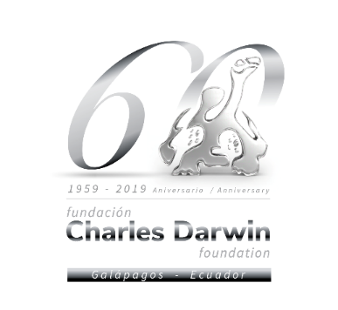
We are celebrating sixty years!
The Charles Darwin Foundation was created in 1959 as part of a collaborative effort between UNESCO, IUCN, and the Government of Ecuador.

Slide 3
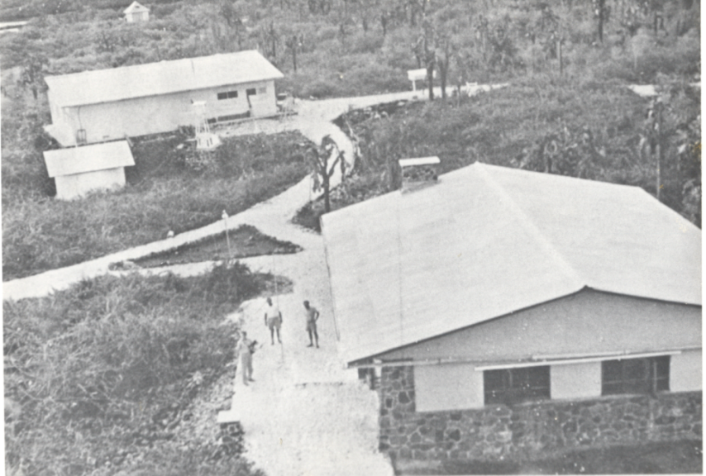
The Charles Darwin Research Station in the mid 60`s…

Slide 4
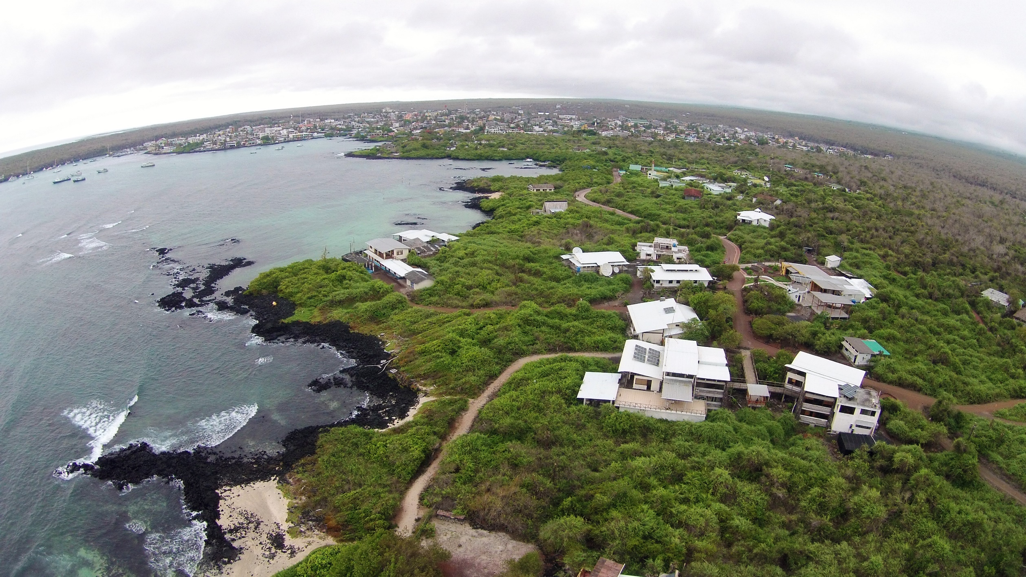
…and today

Slide 5
Our mission
To provide knowledge and assistance through scientific research and complementary action to ensure the conservation of the environment and biodiversity in the Galapagos Archipelago.

Slide 6
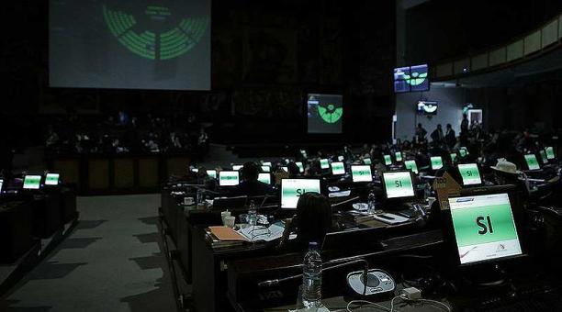
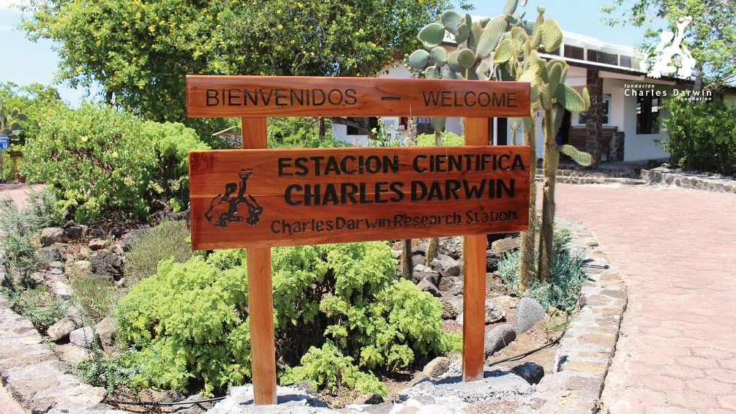
Ecuador General Assembly approved a cooperation agreement

Slide 7
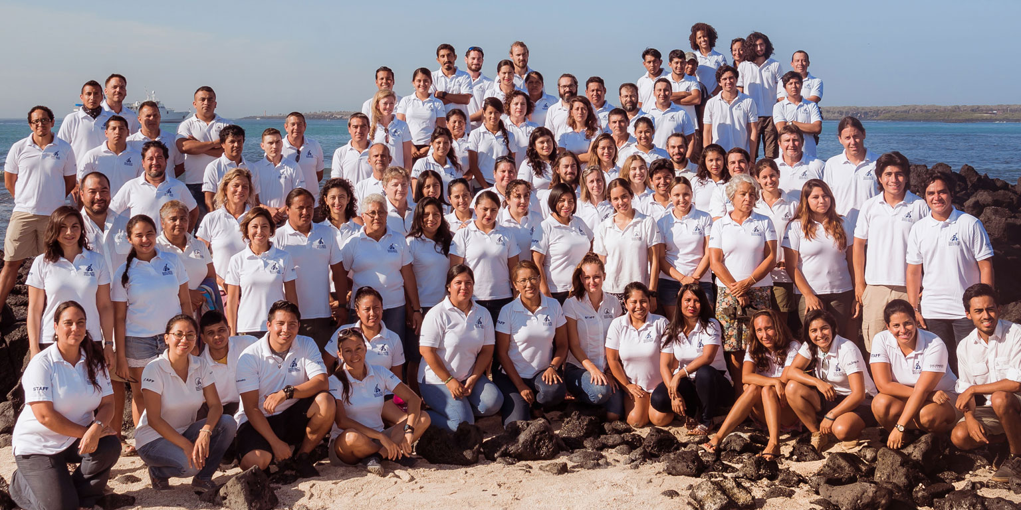
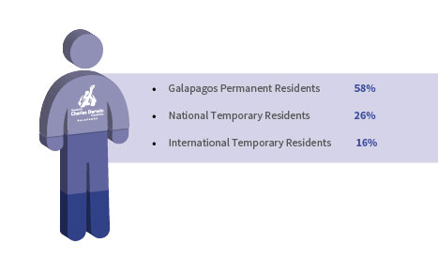
Our staff

Slide 8
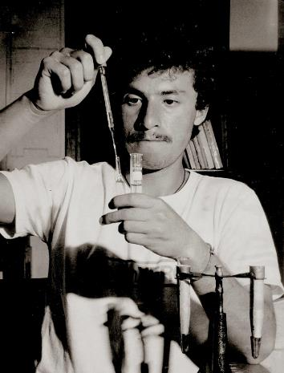
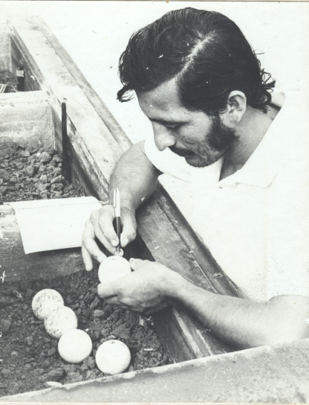
Our first major challenge …and success!

Slide 9
Identifying invasive marine species
© Pelayo Salinas / CDF
Notes:
We work with local government authorities on prevention, early detection and rapid response strategies in order to protect the marine biodiversity of the Galapagos Marine Reserve.

Slide 10
Controlling invasive plants
© Heinke Jäger / CDF
Notes:
We are studying the impacts of invasive species such as blackberry, Cuban cedar, guava and red quinine with the aim of improving control actions to reduce their abundance.

Slide 11
Controlling an invasive fly
©Tui de Roy / CDF
Notes:
The introduced parasitic fly Philornis downsi is believed to be the main cause of the decline of landbird species on the Galapagos Island. Therefore, we have been coordinating a multi-institutional working group to investigate methods for controlling this dangerous invasive species.

Slide 12
Evaluating status and ecology of landbirds
Notes:
We are working on strategies to detect species declines in a timely manner and evaluate the status of landbirds in the archipelago.

Slide 13
Education and community outreach
© Liza Díaz Lálova / CDF
Notes:
Sharks and the Local Community
In 2016, the Charles Darwin Foundation designed and implemented an educational outreach campaign called ‘Protect the fins and the ocean wins’ to promote sustainable co-existence between sharks and humans within the Galapagos Marine Reserve.

Slide 14
Volunteers and scholarship grantees
110 Volunteers
5 Galapagos student Scholarships
26% Permanent Residents
36% Mainland Residents
38% International

Slide 15
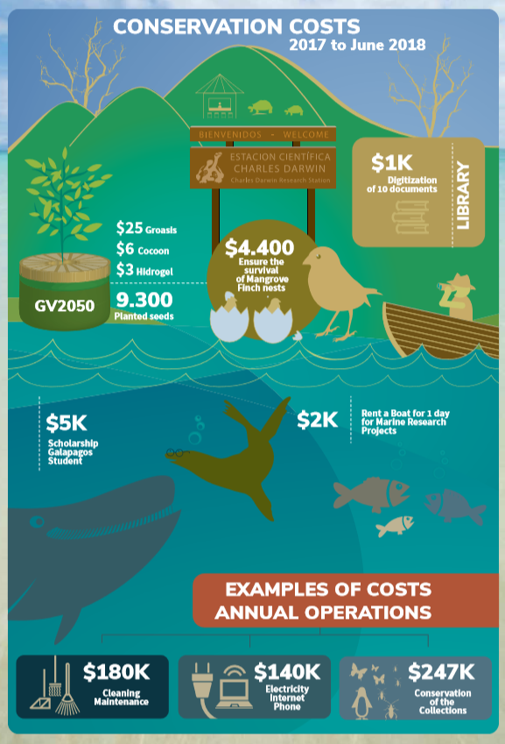
Conservation costs in Galapagos
5 million dollars per year to operate
a research station in Galapagos!

Slide 17
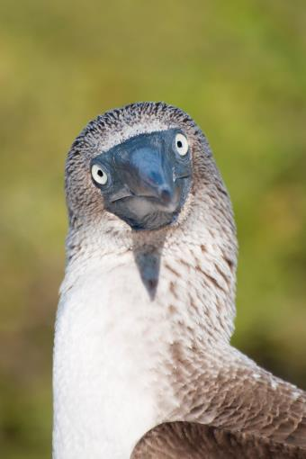
Join us in protecting Galapagos!
Sign up for our newsletter
Check our website and our annual report
Follow us on social media
Volunteer with us
Tell your AWESOME Expedition Leader that you’d like to give to the LEX-NG Fund
Any questions?
© Sam Rowley / CDF

Slide 18
THANKS
Email: cdrs@fcdarwin.org.ec
Website: www.darwinfoundation.org

