Slide 1
Título
Nombre Apellido
Fecha
email@fcdarwin.org.ec

Slide 2
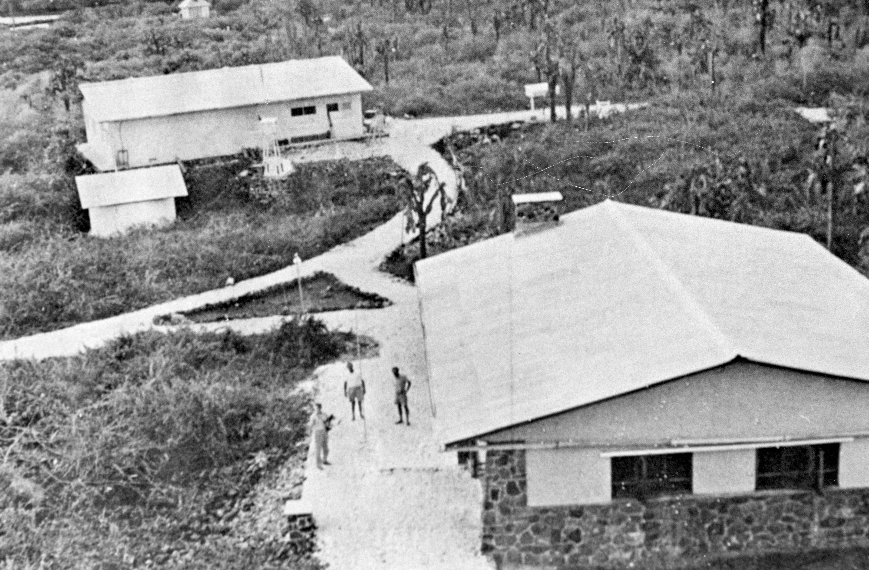
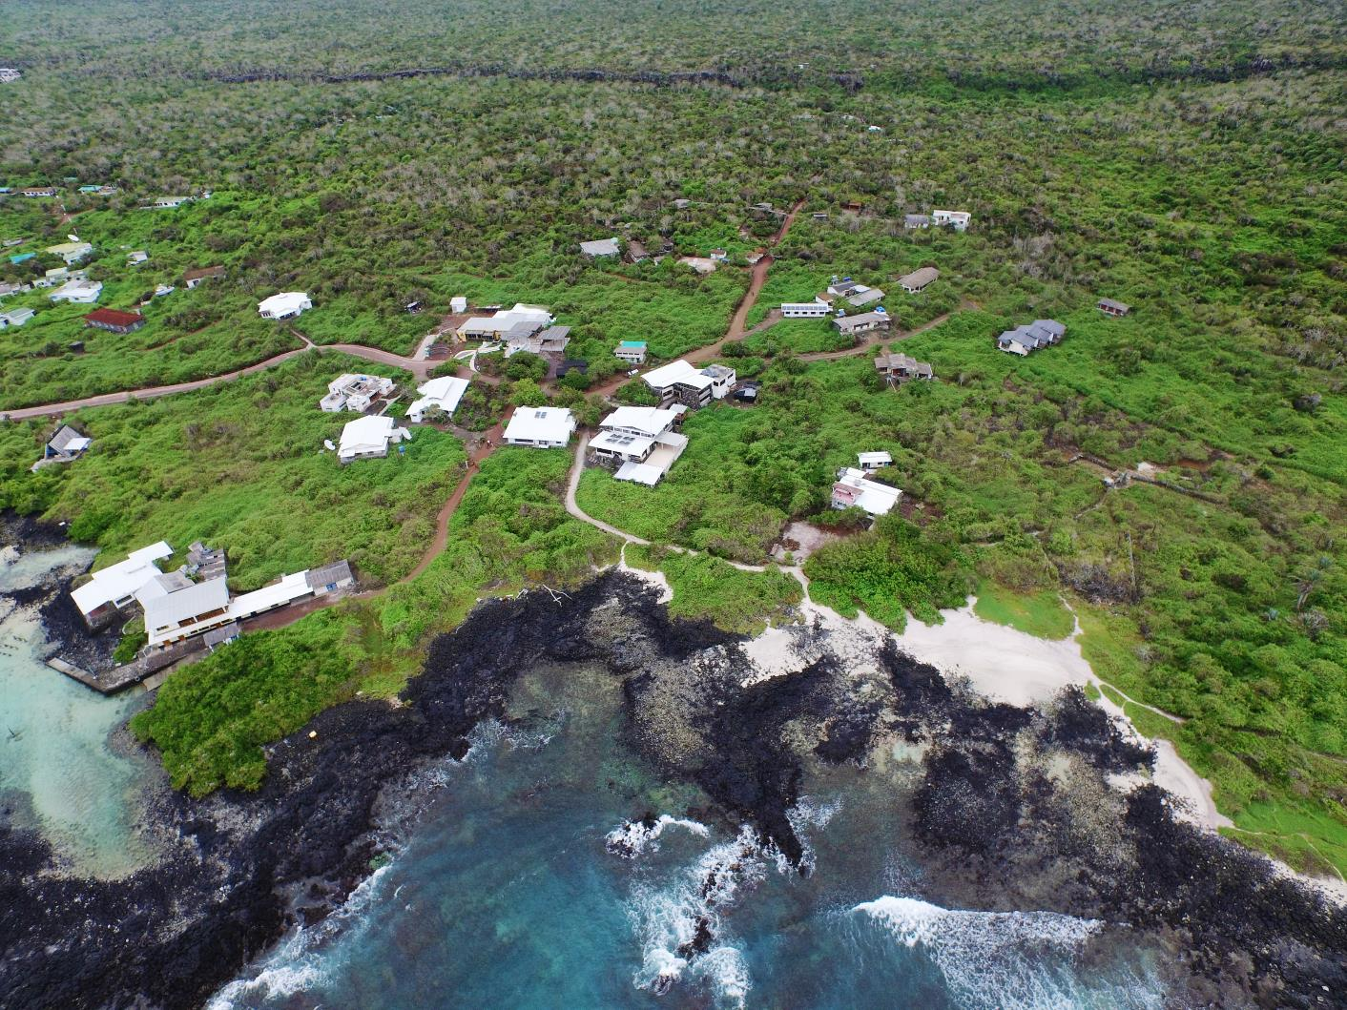
From then…
… to now
Notes:
Created in 1959 as part of a collaborative effort between UNESCO, IUCN, and the Government of Ecuador. We just celebrated 60 years of operation.

Slide 3
Our Mission
To provide knowledge and assistance through scientific research and complementary action to ensure the conservation of the environment and biodiversity in the Galapagos Archipelago.

Slide 4
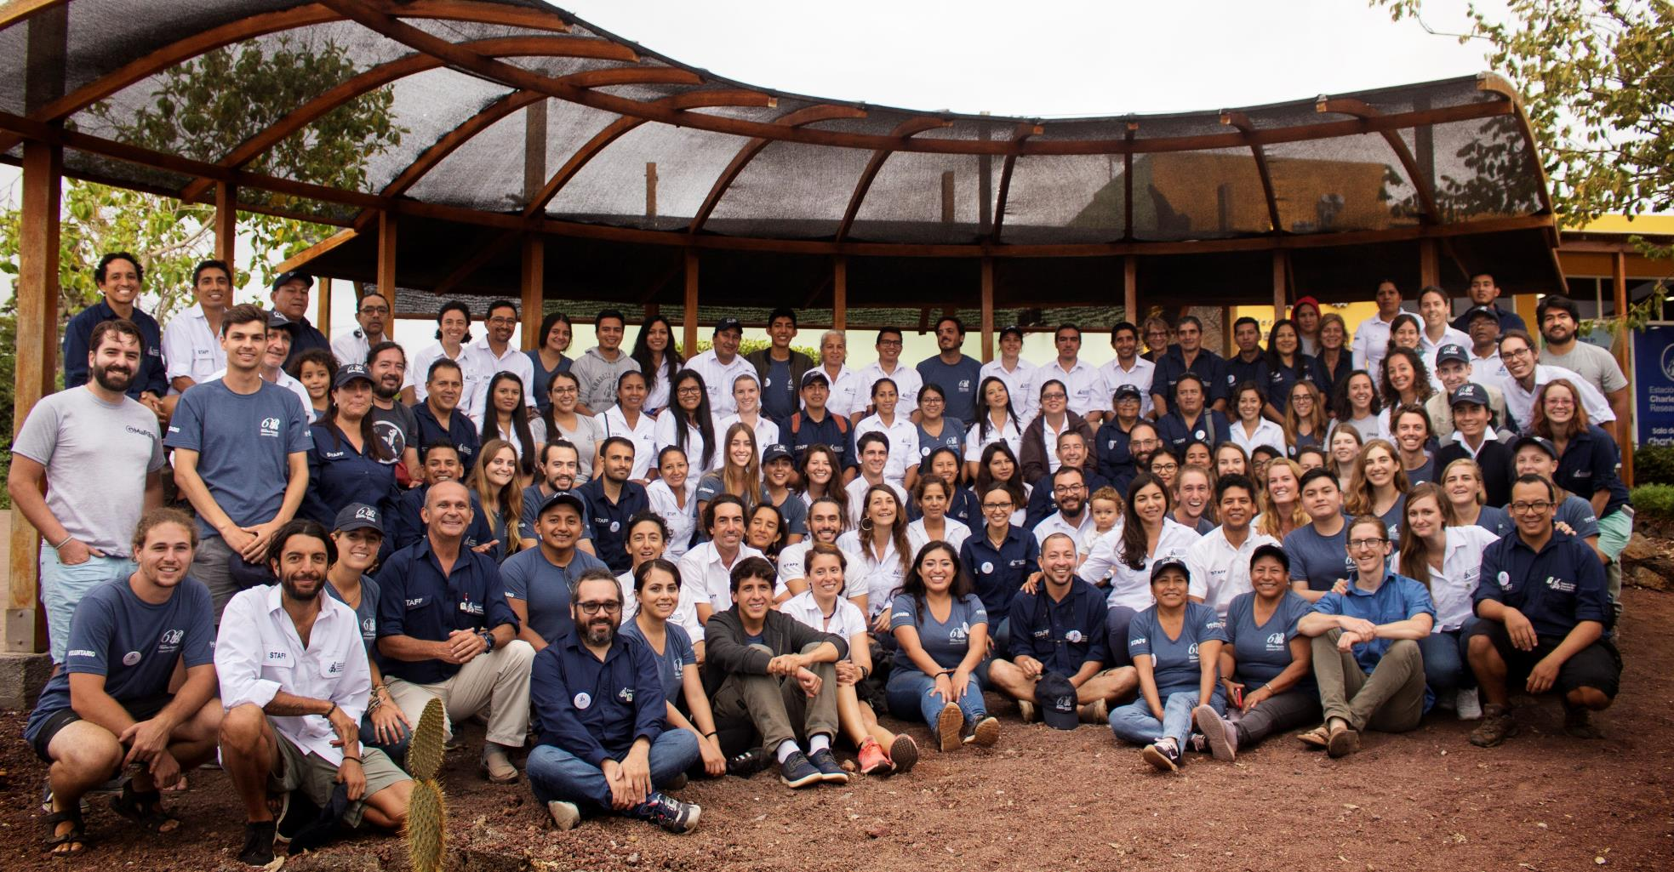
Approx. 100 Staff 100 Volunteers per year 53% Women 47% Men 20% Internationals 26% Ecuadorians 54% Locals
Notes:
Our Staff is made up of approximatly 100 scientists and administrators
Approx X volunteers per year and X visiting scientists

Slide 5
Notes:
CDF works in 3 main research areas: Sustainable development and human wellbeing, Conservation etc. ..

Slide 6
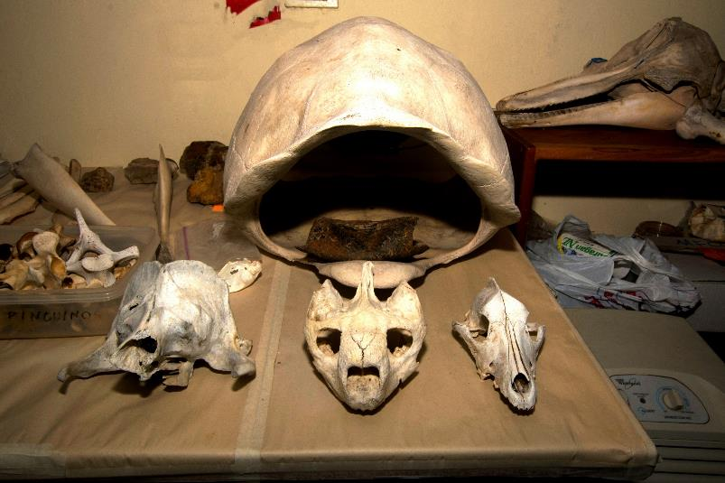
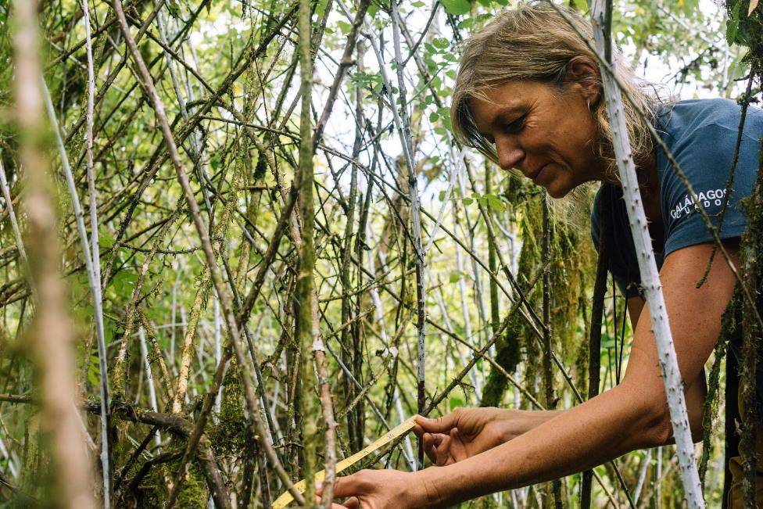
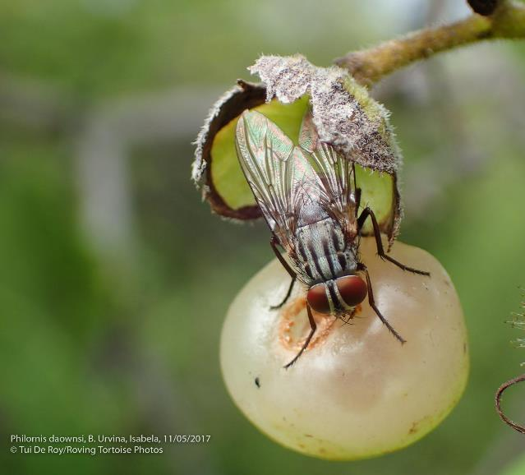
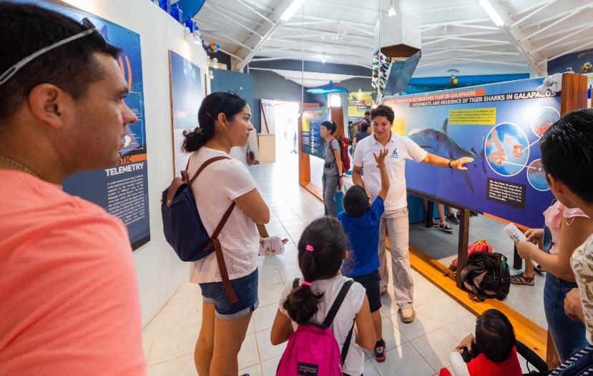
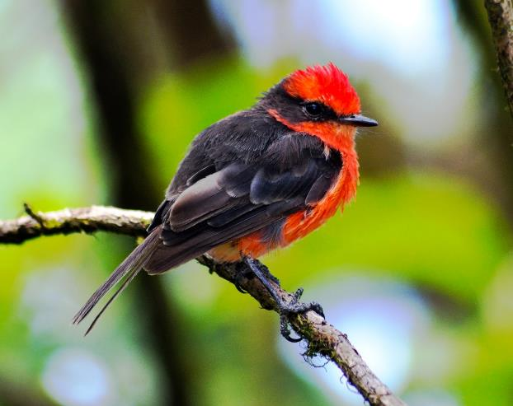
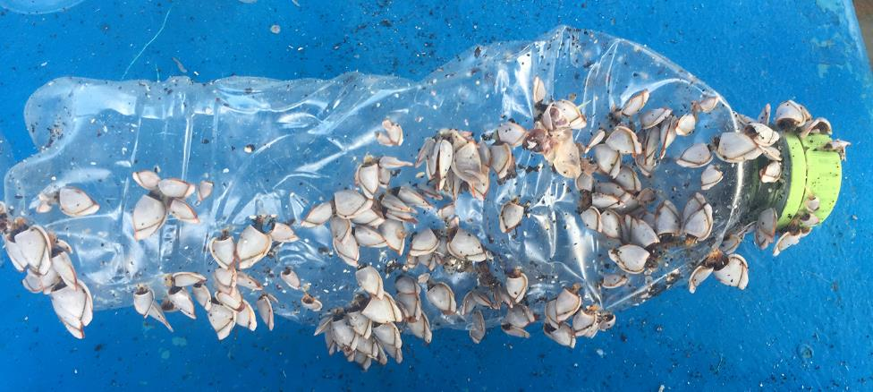
Notes:
-Longterm partnership with Lindblad Expediaiton National Geographic resulted in over $5 Million granted to CDF. CDF is a private NGO that relys on 100% donations. Patrnerships like what we have with LEX-NG ensures our projects and station stay running so we can carry out our mission.
-The funds that are raised onboard from the guests are what makes up this fund.
-They have specifically funded a wide variety of projects over the years. Currently, they support Philornis and land birds, Invasive plants and invertebrates, marine invasives, collections, education, seamounts and operational support.

Slide 7
Title Text

Slide 8
Title Text

Slide 9
Title Text

Slide 12
Current Donors

